Slide 1

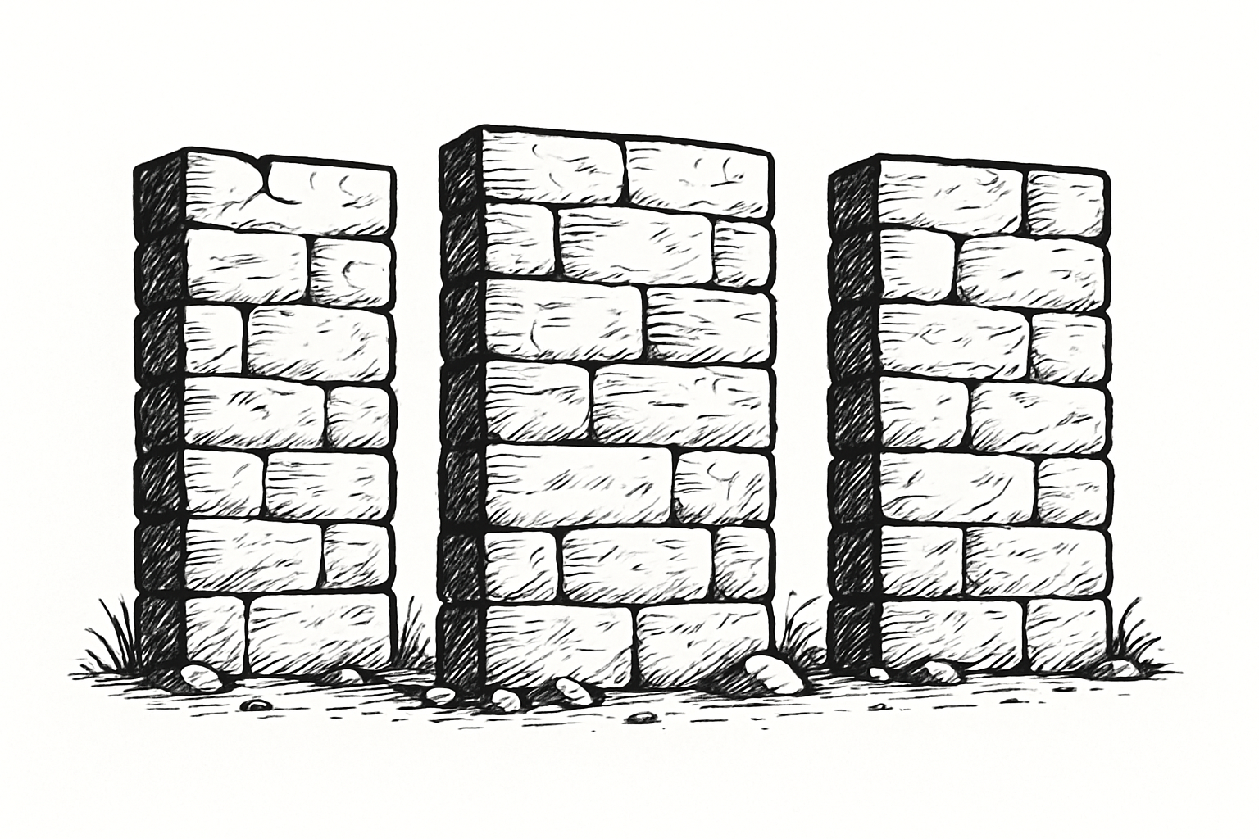
The Three Walls Facing E-commerce and Web3
Hello. We are here to address three major walls that modern e-commerce and Web3 are facing.
While they may seem separate, they are, in fact, deeply interconnected.

Slide 2
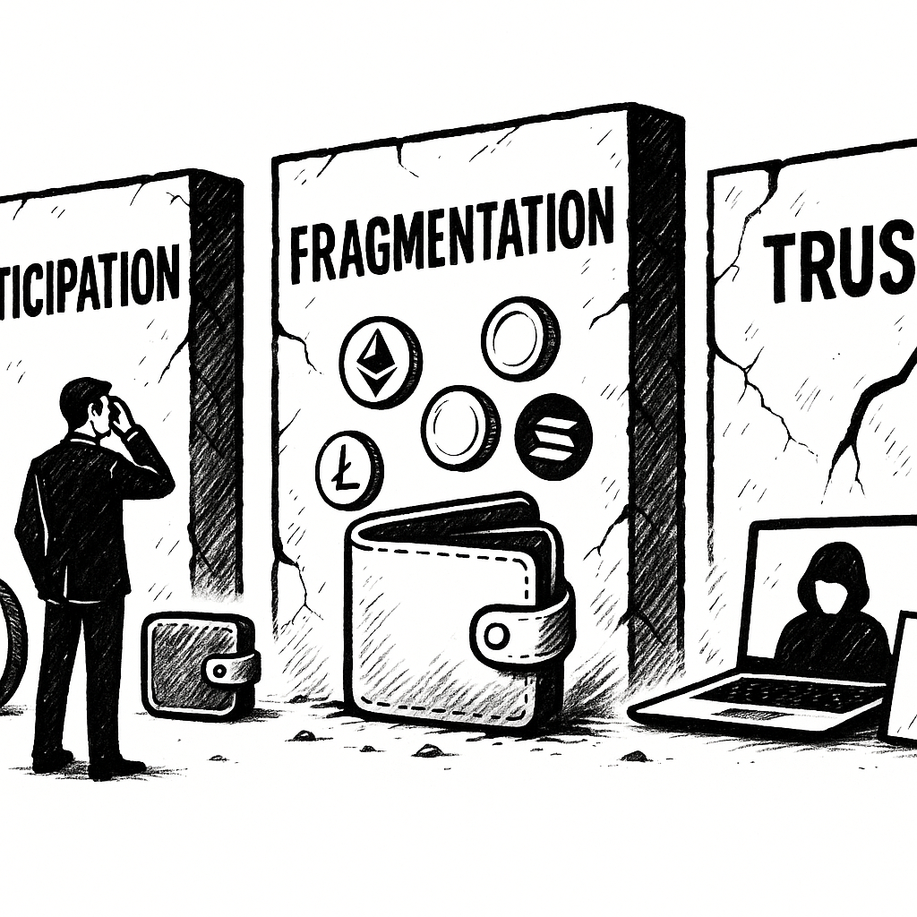
The Wall of Participation: The Hurdle to Mass Adoption.
For most people, crypto is still viewed as an object of "investment" or "speculation." The complexity of wallet creation prevents them from experiencing its practical value in everyday life.
The Wall of Fragmentation: The Hassle of Wallet Management.
Even existing Web3 users struggle with managing different wallets for each chain, like Ethereum and Solana. Assets are fragmented, and the user experience remains complicated.
The Wall of Trust: Fraud and Distrust in Cross-Border E-commerce.
As global transactions grow, platform-dependent reputation systems are failing. There is no environment where everyone can trade with confidence.

Slide 3
Solution - Crypify's Integrated Solution
Crypify dismantles these three walls through a single, seamless flow that begins with the customer's purchase experience.
Solution 1: Dismantling the Wall of Participation with an Intuitive Web3 Experience
"First, a user simply makes a purchase on an e-commerce site with their credit card, just as they always do.
No special actions are required. Upon receiving the confirmation email, they just click a button to view their wallet. Leveraging cutting-edge technologies like Account Abstraction, users are never forced to memorize complex seed phrases.
A non-custodial wallet is instantly created and accessible with only their email address and a passkey, such as a fingerprint or facial recognition.
Behind the scenes, we use Coinbase's CDP Embedded Wallet to automatically convert the credit card payment into USDC.
And look. The wallet has already been credited with 10 USDC in loyalty points from the shop. This empowers everyone to step into the world of Web3 seamlessly and risk-free.

Slide 4
Solution 2: Dismantling the Wall of Fragmentation with a Unified Wallet
"Furthermore, this wallet is, by its very nature, a multi-chain smart wallet. This means you can manage assets across diverse chains—such as Ethereum, Solana, and Base—all from one single hub.
Solution 3: Dismantling the Wall of Trust with an On-Chain Reputation System
"And this unified wallet serves as the foundation for our ultimate goal: the on-chain reputation system. Post-transaction, both buyers and sellers can leverage the Ethereum Attestation Service (EAS) to record any dispute history directly on the blockchain.
This means that as long as you transact honestly, your score remains clean. This creates an immutable reputation that transcends platform boundaries, establishing a universal 'Proof of Trust.' Personal purchase histories are kept private and secure with vlayer's ZK technology."

Slide 5
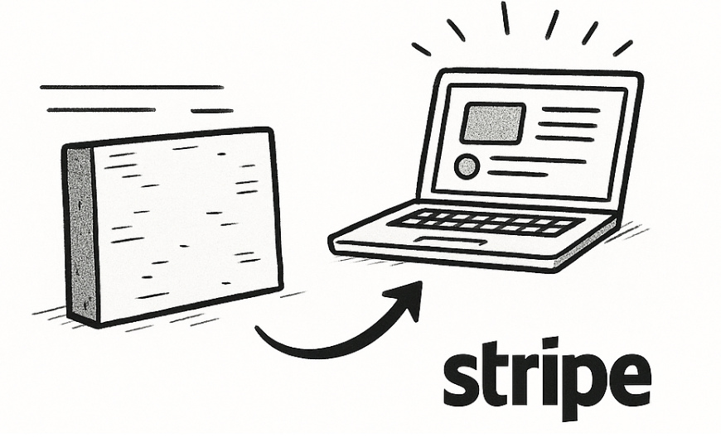
Part 3: Future - The Vision of Crypify
Crypify is far more than just a payment or wallet application. It is the foundational infrastructure that unifies fragmented trust and assets to forge a fairer, more global marketplace.
And implementation is remarkably simple.
Just like Stripe, it can be integrated into any e-commerce site with only a few lines of code.
Thank you for your time.

